Slide 1
Chapter 15
How to work with interfaces and generics

Slide 2
Objectives
Applied
Use .NET interfaces as you develop the classes for an application.
Develop and use your own interfaces.
Knowledge
Distinguish between an interface and an abstract class.
Describe the use of the .NET ICloneable, IComparable<>, and IEnumerable<> interfaces.
In general terms, describe the use of default methods as well as static fields and methods in interfaces.
In general terms, describe the use of generic interfaces.

Slide 3
The IDisplayable interface
interface IDisplayable
{
string GetDisplayText(string sep);
}

Slide 4
A Product class that implements the IDisplayable interface
public class Product : IDisplayable
{
public string Code { get; set; }
public string Description { get; set; }
public decimal Price { get; set; }
public Product(string Code, string Description,
decimal Price)
{
this.Code = Code;
this.Description = Description;
this.Price = Price;
}
public string GetDisplayText(string sep) =>
this.Code + sep + this.Description + sep +
this.Price.ToString("c");
}

Slide 5
Code that uses the IDisplayable interface
IDisplayable product = new Product(
"C#", "Murach's C#", 59.50m);
Debug.WriteLine(product.GetDisplayText("\n"));

Slide 6
A comparison of interfaces and abstract classes
Both interfaces and abstract classes can provide signatures for properties and methods that a class must implement.
Both interfaces and abstract classes can implement some or all of their properties and methods.
An abstract class can use instance variables and constants as well as static variables and constants. An interface can only use static variables and constants.
A class can inherit only one class (including abstract classes), but a class can implement more than one interface.

Slide 7
Common .NET interfaces
Interface Members
ICloneable object Clone()
IComparable int CompareTo(object)
IConvertible TypeCode GetTypeCode() decimal ToDecimal() int ToInt32() ...
IDisposeable void Dispose()

Slide 8
Common .NET interfaces for collections (part 1)
Interface Members
IEnumerable IEnumerator GetEnumerator()
IEnumerator object Current bool MoveNext() void Reset()
ICollection int Count bool IsSynchronized object SyncRoot void CopyTo(array, int)
IList [int] int Add(object) void Clear() void Remove(object) void RemoveAt(int)

Slide 9
Common .NET interfaces for collections (part 2)
Interface Members
IDictionary [int] ICollection Keys ICollection Values int Add(object) void Remove(object) void Clear()

Slide 10
The syntax for creating an interface
public interface InterfaceName { modifier type MethodName(parameters);
modifier type PropertyName
{
[get;]
[set;]
}
... }

Slide 11
An interface that defines one method
public interface IDisplayable
{
string GetDisplayText(string sep);
}
An interface that defines two methods and a property
public interface IPersistable
{
object Read(string id);
bool Save(object o);
bool HasChanges
{
get;
set;
}
}

Slide 12
The syntax for creating an interface that inherits other interfaces
public interface InterfaceName : InterfaceName1
[, InterfaceName2]...
{
interface members...
}
An interface that inherits two interfaces
public interface IDataAccessObject : IDisplayable, IPersistable
{
// add additional members here
}

Slide 13
The syntax for implementing an interface
public class ClassName : [BaseClassName,]
InterfaceName1[, InterfaceName2]...
A Product class that implements ICloneable
public class Product : ICloneable
A Product class that implements two interfaces
public class Product : ICloneable, IDisplayable
A class that inherits a class and implements two interfaces
public class Book : Product, ICloneable, IDisplayable

Slide 14
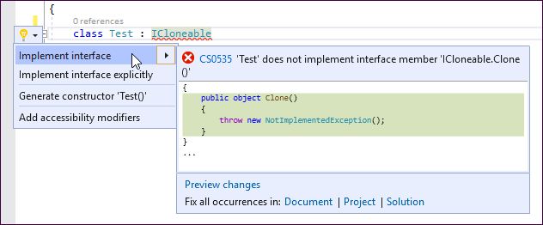
The Quick Actions menu for an interface name

Slide 15
The code that’s generated when you implement the interface
public object Clone()
{
throw new NotImplementedException();
}
The code that’s generated when you explicitly implement the interface
object ICloneable.Clone()
{
throw new NotImplementedException();
}

Slide 16
The code for the cloneable Product class (part 1)
public class Product : IDisplayable, ICloneable
{
public string Code { get; set; }
public string Description { get; set; }
public decimal Price { get; set; }
public Product(string Code, string Description,
decimal Price)
{
this.Code = Code;
this.Description = Description;
this.Price = Price;
}
public string GetDisplayText(string sep) =>
this.Code + sep + this.Description + sep +
this.Price.ToString("c");

Slide 17
The code for the cloneable Product class (part 2)
public object Clone()
{
Product p = new Product();
p.Code = this.Code;
p.Description = this.Description;
p.Price = this.Price;
return p;
}
}

Slide 18
Code that creates and clones a Product object
Product p1 = new Product("BJWN",
"Murach's Beginning Java with NetBeans", 57.50m);
Product p2 = (Product)p1.Clone();
p2.Code = "BJWE";
p2.Description = "Murach's Beginning Java with Eclipse";
Debug.WriteLine(p1.GetDisplayText("\n") + "\n");
Debug.WriteLine(p2.GetDisplayText("\n") + "\n");
The output that’s displayed
BJWN
Murach's Beginning Java with NetBeans
$57.50
BJWE
Murach's Beginning Java with Eclipse
$57.50

Slide 19
A CreateList() method that uses an interface as a parameter
public static List<object> CreateList(ICloneable obj,
int count)
{
List<object> objects = new List<object>();
for (int i = 0; i < count; i++)
{
object o = obj.Clone();
objects.Add(o);
}
return objects;
}
A WriteToDebug() method that uses an interface as a parameter
public static void WriteToDebug(IDisplayable d) =>
Debug.WriteLine(d.GetDisplayText("\n") + "\n");

Slide 20
Code that uses the methods
Product product =
new Product("C#", "Murach's C#", 59.50m);
List<object> products = CreateList(product, 3);
foreach (Product p in products)
{
WriteToDebug(p);
}
The output that’s displayed
C#
Murach's C#
$59.50
C#
Murach's C#
$59.50
C#
Murach's C#
$59.50

Slide 21
The syntax for declaring a default method (C# 8.0 or later)
accessModifier returnType MethodName([parameterlist]) { ... }
An interface that defines a default method
public interface IDisplayable { string GetDisplayText(string terminator) {
return ToString() + terminator;
}
... }

Slide 22
A class that uses the default method
public class Product : IDisplayable {
// This class doesn't override the GetDisplayText() method.
// As a result, it uses the GetDisplayText() method defined
// by the interface.
}
A class that overrides the default method
public class Product : IDisplayable {
public string GetDisplayText(string sep) {
return this.Code + sep + this.Description + sep +
this.Price;
}
}

Slide 23
An interface that defines a static method and a static field
public interface IPrintable {
static string terminator = "\r\n";
static string Print(IDisplayable p) {
return p.GetDisplayText(terminator);
}
}
Code that calls a static method from an interface
IDisplayable product =
new Product("C#", "Murach's C#", 59.50m);
IPrintable.Print(product);

Slide 24
A CustomList<> class that uses generics (part 1)
public class CustomList<T>
{
private List<T> list = new List<T>();
// an Add() method
public void Add(T item) => list.Add(item);
// a read-only indexer
public T this[int i] => list[i];
// a read-only property
public int Count => list.Count;

Slide 25
A CustomList<> class that uses generics (part 2)
// the ToString() method
public override string ToString()
{
string listString = "";
for (int i = 0; i < list.Count; i++)
{
listString += list[i].ToString() + "\n";
}
return listString;
}
}

Slide 26
Code that uses the CustomList<> class
// Test 1
Debug.WriteLine("List 1 - ints");
CustomList<int> list1 = new CustomList<int>();
int i1 = 11;
int i2 = 7;
list1.Add(i1);
list1.Add(i2);
Debug.WriteLine(list1.ToString());
// Test 2
Debug.WriteLine("List 2 - Products");
CustomList<Product> list2 = new CustomList<Product>();
Product p1 = new Product("JAVA",
"Murach's Java Programming", 59.50m);
Product p2 = new Product("C#", "Murach's C#", 59.50m);
list2.Add(p1);
list2.Add(p2);
Debug.Write(list2.ToString());

Slide 27
Output from the Test 1 and Test 2 code
List 1 - ints
11
7
List 2 - Products
JAVA Murach's Java Programming $59.50
C# Murach's C# $59.50

Slide 28
A common generic .NET interface
Interface Member
IComparable<> int CompareTo(T)

Slide 29
Common .NET interfaces for generic collections (part 1)
Interface Members
IEnumerable<> IEnumerator<T> GetEnumerator()
ICollection<> int Count bool IsReadOnly T SyncRoot Add(T) void Clear() bool Contains(T) void CopyTo(array, int) bool Remove(T)
IList<> [int] int IndexOf(T) void Insert(int, T) void RemoveAt(int)

Slide 30
Common .NET interfaces for generic collections (part 2)
Interface Members
IDictionary<> [int] ICollection<K> Keys ICollection<V> Values void Add(K, V) bool ContainsKey(K) bool Remove(K) bool TryGetValue(K, V)

Slide 31
A class that implements the IComparable<> interface
public class Product : IComparable<Product>
{
public string Code { get; set; }
public string Description { get; set; }
public decimal Price { get; set; }
// other members
public int CompareTo(Product other) =>
this.Code.CompareTo(other.Code);
}

Slide 32
Code that uses the class
Product p1 = new Product("JAVA",
"Murach's Java Programming", 59.50m);
Product p2 = new Product("C#", "Murach's C#", 59.50m);
int compareValue = p1.CompareTo(p2);
if (compareValue > 0)
Debug.WriteLine("p1 is greater than p2");
else if (compareValue < 0)
Debug.WriteLine("p1 is less than p2");
else if (compareValue == 0)
Debug.WriteLine("p1 is equal to p2");

Slide 33
Values that can be returned by the CompareTo() method
Value Meaning
-1 The current element is less than the compare element.
0 The current element is equal to the compare element.
1 The current element is greater than the compare element.

Slide 34
A class that uses constraints (part 1)
public class CustomList<T> where T: class, IComparable<T>
{
private List<T> list = new List<T>();
// an Add() method that keeps the list sorted
public void Add(T item) {
if (list.Count == 0) {
list.Add(item);
}
else {
for (int i = 0; i < list.Count; i++) {
T currentItem = list[i];
T nextItem = null;
if (i < list.Count - 1)
{
nextItem = list[i + 1];

Slide 35
A class that uses constraints (part 2)
int currentCompare =
currentItem.CompareTo(item);
if (nextItem == null)
{
if (currentCompare >= 0)
{
list.Insert(i, item);
// insert before current item
break;
}
...
...

Slide 36
Keywords that can be used to define constraints
Keyword Description
class The type argument must be a class.
struct The type argument must be a structure other than one that defines a nullable type.
new() The type argument must have a default constructor. You can’t use this keyword when the type argument must be a structure.
System.Enum The type argument must be of the System.Enum type.
System.Delegate The type argument must be of the System.Delegate type.

Slide 37
A class that’s constrained to value types
public class StructList<T> where T: struct
Another class that uses constraints
public class ProductList<T> where T: Product, IComparable<T>, new()

Slide 38
A class that implements IEnumerable<>
public class CustomList<T> : IEnumerable<T>
{
private List<T> list = new List<T>();
// other members
public IEnumerator<T> GetEnumerator()
{
foreach (T item in list)
{
yield return item;
}
}
System.Collections.IEnumerator
System.Collections.IEnumerable.GetEnumerator()
{
throw new NotImplementedException();
}
}

Slide 39
Code that uses the CustomList<T> class
Product p1 = new Product("JAVA",
"Murach's Java Programming", 59.50m);
Product p2 = new Product("C#", "Murach's C#", 59.50m);
CustomList<Product> list = new CustomList<Product>();
list.Add(p1);
list.Add(p2);
foreach (Product p in list)
{
Debug.WriteLine(p.ToString());
}

Slide 40
An interface named IGenericPersistable<> that uses generics
interface IGenericPersistable<T>
{
T Read(string id);
bool Save(T obj);
bool HasChanges
{
get;
set;
}
}

Slide 41
A class that implements IGenericPersistable<> (part 1)
class Customer : IGenericPersistable<Customer>
{
// other members
public Customer Read(string id)
{
throw new NotImplementedException();
}
public bool Save(Customer obj)
{
throw new NotImplementedException();
}

Slide 42
A class that implements IGenericPersistable<> (part 2)
public bool HasChanges
{
get
{
throw new NotImplementedException();
}
set
{
throw new NotImplementedException();
}
}
}

Slide 43
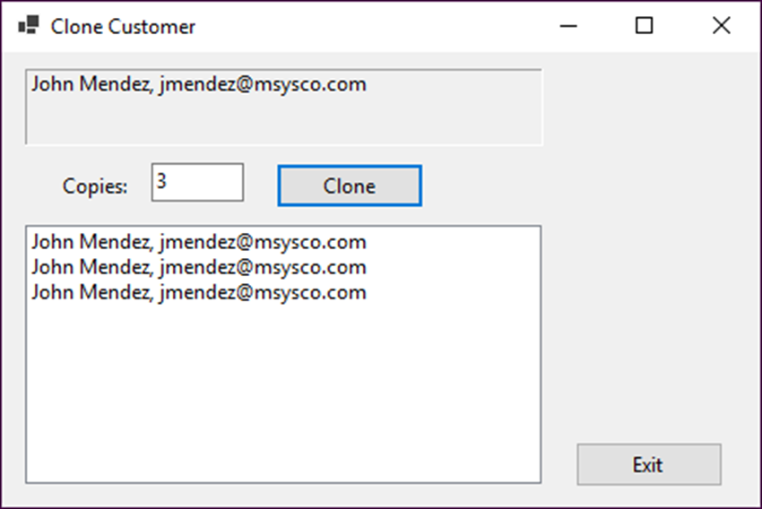
Exercise 15-1 Implement the ICloneable interface
Add code to a Customer class so it implements the ICloneable interface. Then, create a List<> that contains the requested number of clones and display the clones in a list box.

Slide 44
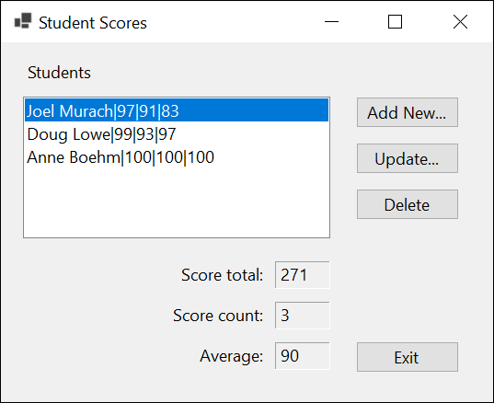
Project 3-5 Maintain student scores (Student class)
Develop an application that maintains a list of student scores using a Student class. This class will implement the ICloneable interface and the Clone method will implement a deep copy.

Slide 45
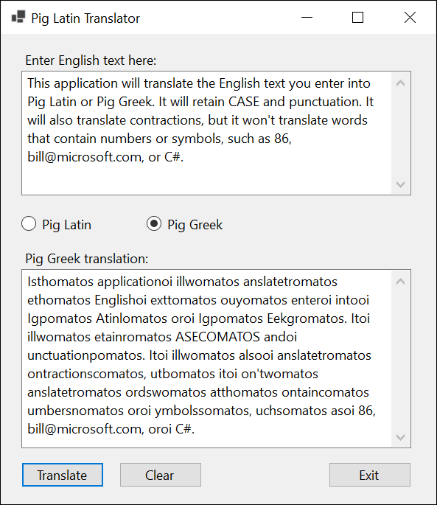
Project 3-6 Translate English to Pig Latin or Pig Greek
Create a form that converts a text entry to Pig Latin or Pig Greek. To do that, you’ll create an interface named ITranslator and two classes that provide the translations by implementing this interface.

Slide 46
Objectives
Applied
Use .NET interfaces as you develop the classes for an application.
Develop and use your own interfaces.
Knowledge
Distinguish between an interface and an abstract class.
Describe the use of the .NET ICloneable, IComparable<>, and IEnumerable<> interfaces.
In general terms, describe the use of default methods as well as static fields and methods in interfaces.
In general terms, describe the use of generic interfaces.

